Slide 1
Ascog Farm / Community Wind Energy Project
Bute Community Council 21.11.2012
Adrian Tear
adrian.tear@ascogfarm.com
www.ascogfarm.com

Slide 2
Introduction
1
2
3
Who?
What?
Why?
Read more online at www.ascogfarm.com

Slide 3
Who?
1
Adrian Tear:
BA Hons Geography (Durham)
MSc Geographic Information Systems (Edinburgh)
PhD Geography (part time, Portsmouth)
20 years visiting/staying on Bute
Elspeth McVey:
MA Hons Geography (Edinburgh)
MSc Geographic Information Systems (Edinburgh)
Grew up on Bute/always coming back
Patrick (15), Roslyn (13), Charlie (8):
All have been coming to Bute since born
Strong family ties to Bute and well known in the local farming community

Slide 4
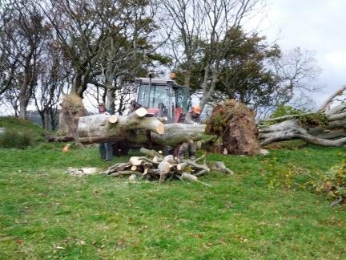
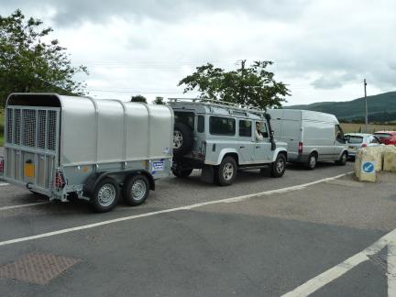
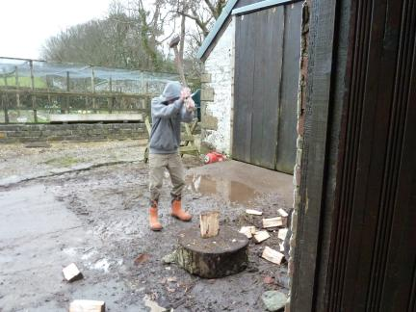
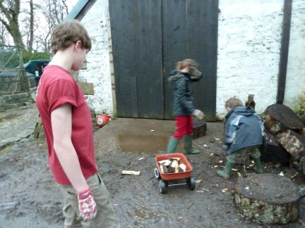
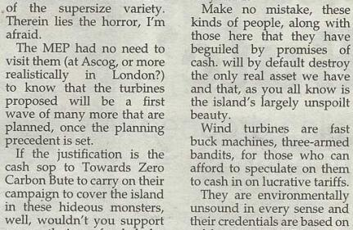
We are not a £billion power company
From and often on Bute!

Slide 5
Track record
Business Geographics Limited:
Co-founded 1993, aged 24 with no capital
Created 5 permanent jobs
Sold 1997-2000 in a £x,xxx,xxx deal
Allegran Limited:
Co-founded 2002, aged 33 with £25k loan
Created 20 permanent jobs
Sold 2006-2007 in a £xx,xxx,xxx deal
‘Disruptive’ technologies:
Early
Inventive/adaptable
Successful
Do nothing or something?

Slide 6
What?
2
Three wind turbines:
Each 50m high to the hub
48m diameter blades making 74m to ‘blade tip’
Rated at 900kW for a 2.7mW scheme in all
Capital expenditure:
~ £3.5m (Co-op bank borrowing?)
Outputs:
~ 8.28 GWh/year
Offsetting ~ 3,612 tonnes CO2 equivalent
Equates to consumption of ~ 2,133 homes
“Scotland has massive green energy potential” (Fergus Ewing)

Slide 7
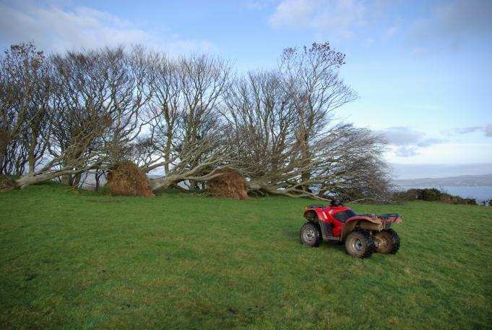
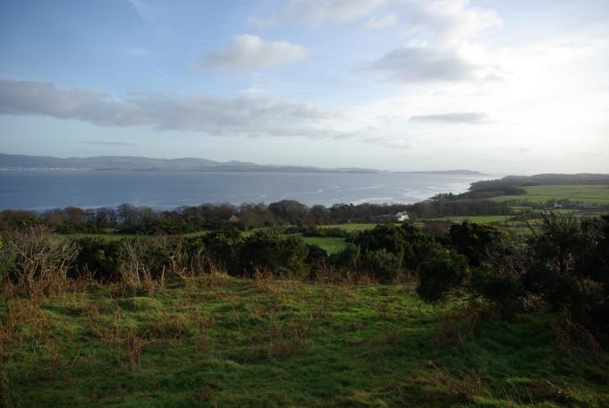
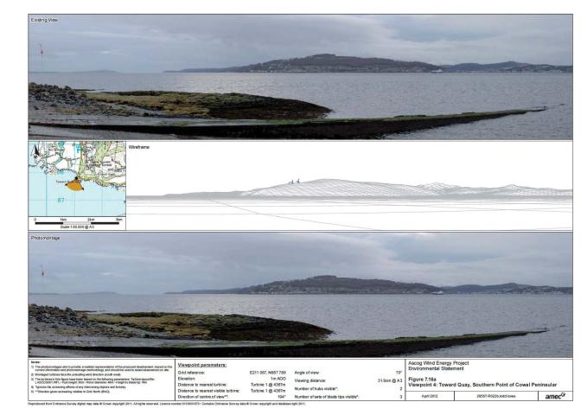
Ascog Farm
A windy hill top site!

Slide 8
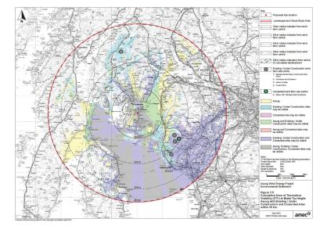
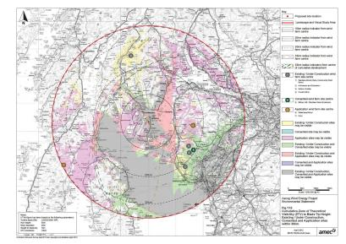
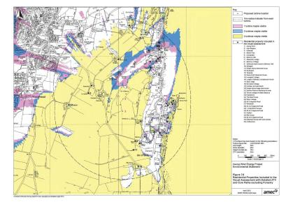
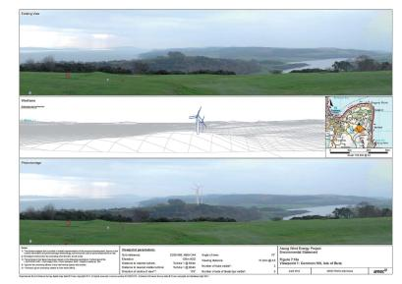
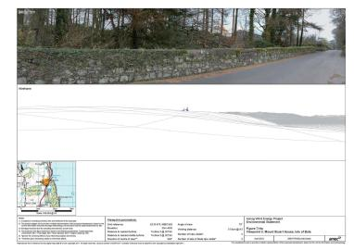
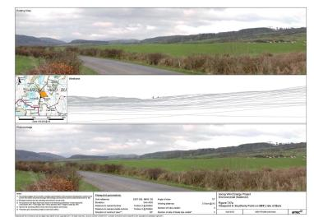
Visibility?
Depends on viewpoint…

Slide 9
Why?
3
Ascog Farm:
150 acres
Privately owned
Windy hill top site (as we have found out)
Personally:
Backgrounds in Environmental Science
Aware of/concerned by climate change (& young)
Opportunity to diversify farm
The wider community:
Bute is poor and little has changed in 20 years
Green Energy is the UK’s only growth sector
Community fund could be worth ~ £1.5m
“Unlock the green energy potential of your land” (Richard Lochhead)

Slide 10
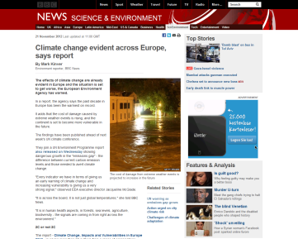
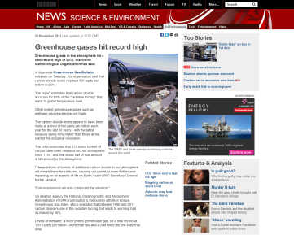
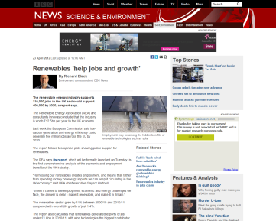
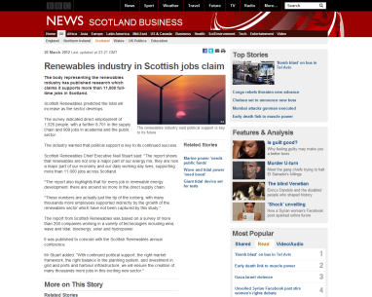
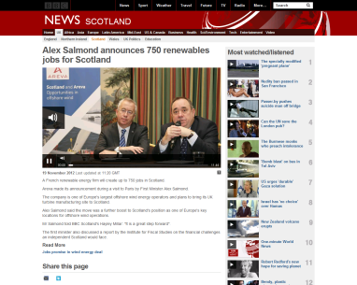
Why bother?
Change brings opportunity

Slide 11
What about wind speeds?
Good wind speeds!

Slide 12
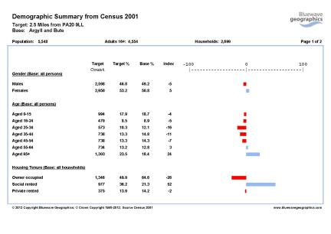
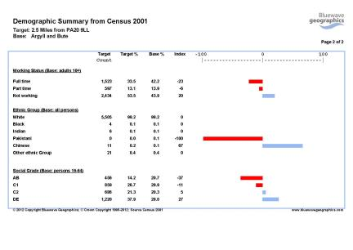
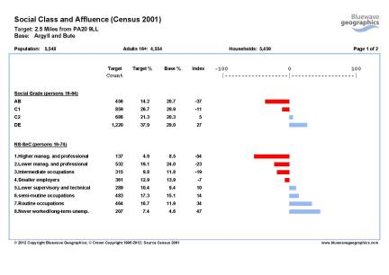
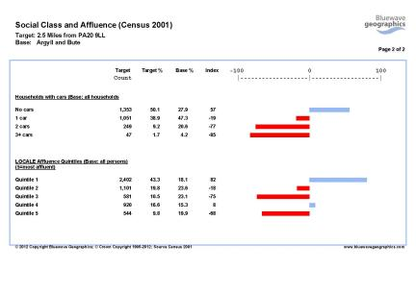
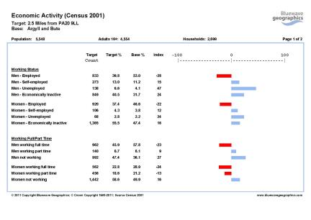
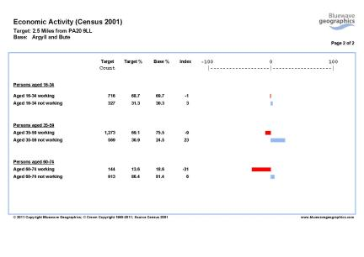
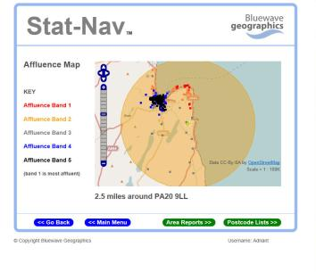
Would a Community Fund benefit anyone?
Potentially lots of people…

Slide 13
Why not?
Views:
Turbines will indisputably alter the landscape
There is no evidence this affects visitor numbers
There are many worse things to look at on Bute
Noise:
Modern turbines are very quiet
The topography of the site shields most houses
Elsewhere, the sewage/water works are already noisy
Health:
There is no ‘peer-reviewed’ evidence of health problems
‘Wind Turbine Syndrome’ is very much unproven
Go over to Ardrossan or Largs and ‘give it a go’
Views, Noise and Health

Slide 14
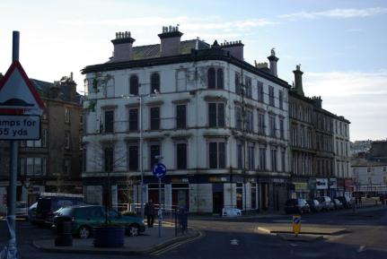
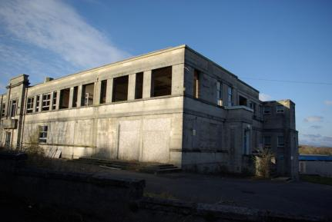
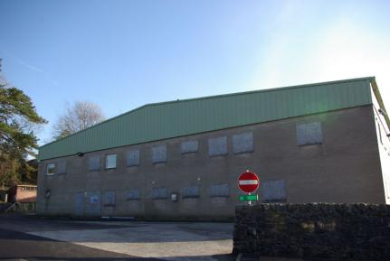
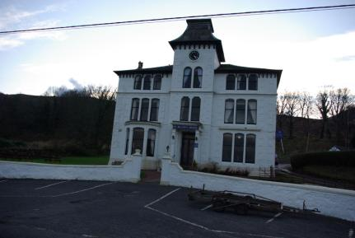
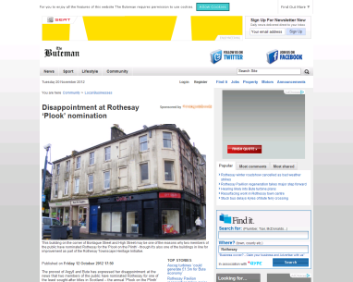
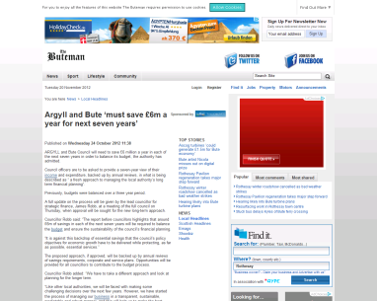
Anything worse to look at?
Nirvana or Plook?

Slide 15
Will they fry your brains?
Other than perhaps the aftermath of a nuclear blast on population health, there is nothing known to medicine that comes close to the morbid apocalypse that is being megaphoned by anti-wind groups. It is not just illnesses and symptoms that occur but "deaths, yes, many deaths mainly from unusual cancers", which have strangely never come to the attention of any coroner. Did you know that wind turbines can cause lung cancer, leukaemia, diabetes, herpes, "electromagnetic spasms in the skull", infertility and the ghastly sounding "loss of bowels"? Any very common problem together affecting literally millions of people across Australia (sleep problems, high blood pressure, lack of concentration, forgetfulness, children doing poorly at school, nosebleeds and muscle twitches) can all be explained by wind turbine exposure…
Is this magic?
Australian Professor of Public Health Simon Chapman Wind turbines power mass hysteria (23.05.2012)
Beware of the scare…

Slide 16
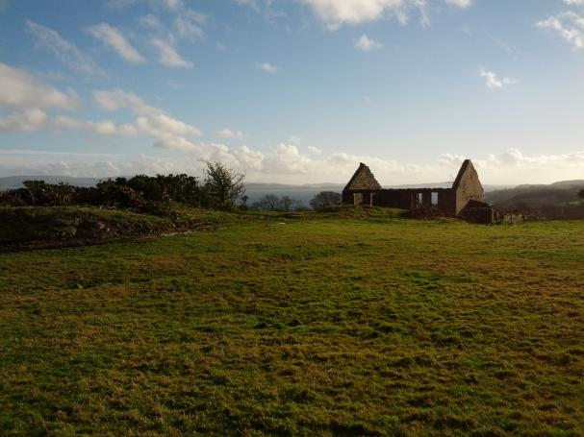
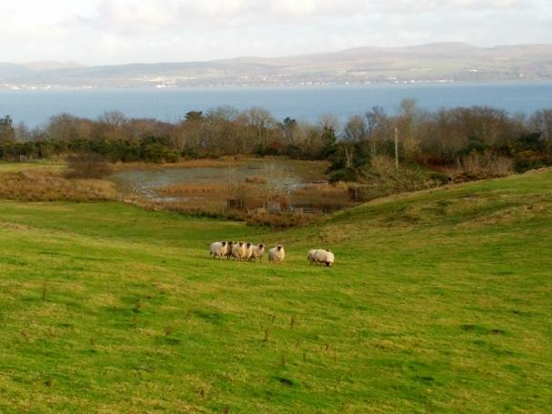
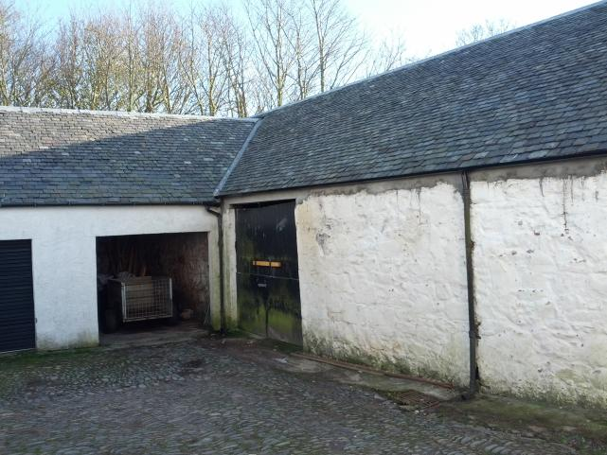
Potential ‘Spin-Offs’
Turbine Trail and Visitor Centre:
A good walk and an energy through the ages display?
Hydro (remnants), Coal, Nuclear and Wind all around
Visitor Centres at turbine sites are popular
Ice Rink:
All-year powered by green energy?
Skating and Curling
Could be quite an attraction
Micro-brewery:
Old sheds at Ascog could house one?
Fyne Ales at Cairndow has done well
Raise your glasses to a pint of ‘Megawatt Temptation’!
Longer term ideas…

Slide 17
Ascog is a windy site and revenue from electricity sales diversifies the farm and would benefit Bute more widely through the TZCB community fund
The landscape has always changed and will continue to…

Slide 18
Understanding the evidence is critical Read the Environmental Statement online, in the Library or at the offices of Towards Zero Carbon Bute. Uninformed or misinformed is non-informed!
Summary
The only thing we have to fear is fear itself!

Slide 19
Ascog Farm / Community Wind Energy Project
Bute Community Council 21.11.2012
Adrian Tear
adrian.tear@ascogfarm.com
www.ascogfarm.com

