Slide 1

Planning Protective Services and Licensing Committee
22nd^{th} May 2013

Slide 2
Ref: 12/02202/PP
Erection of 3 wind turbines (74 metres high to blade tip) and turbine control building, formation of access road and hardstanding areas.
Ascog Farm
Balmory Road
Ascog
Isle Of Bute
PA20 9LL

Slide 3
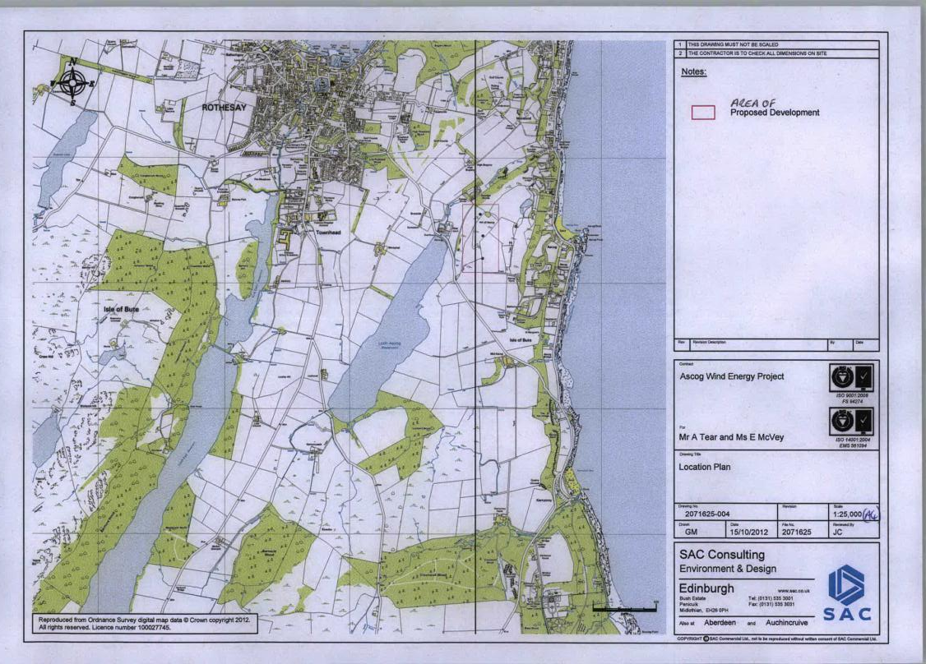

Slide 4
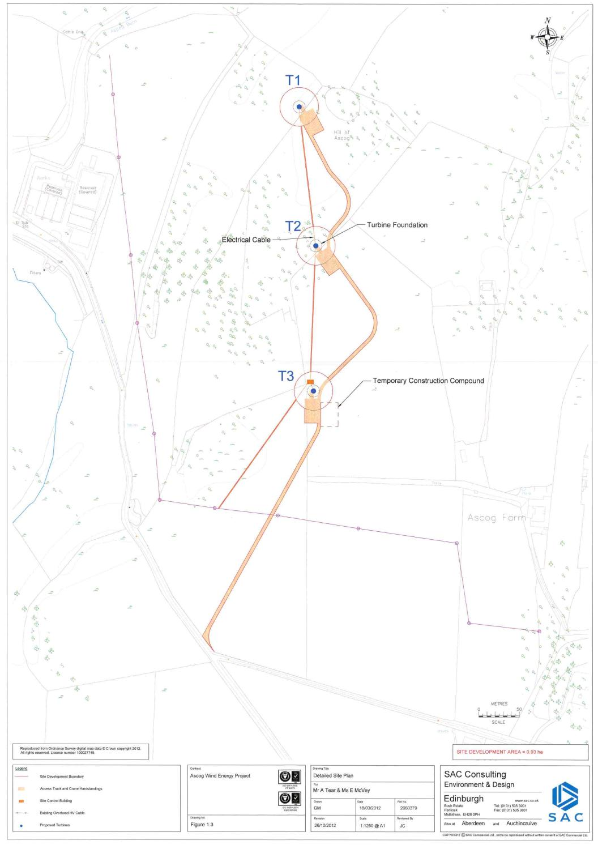

Slide 5
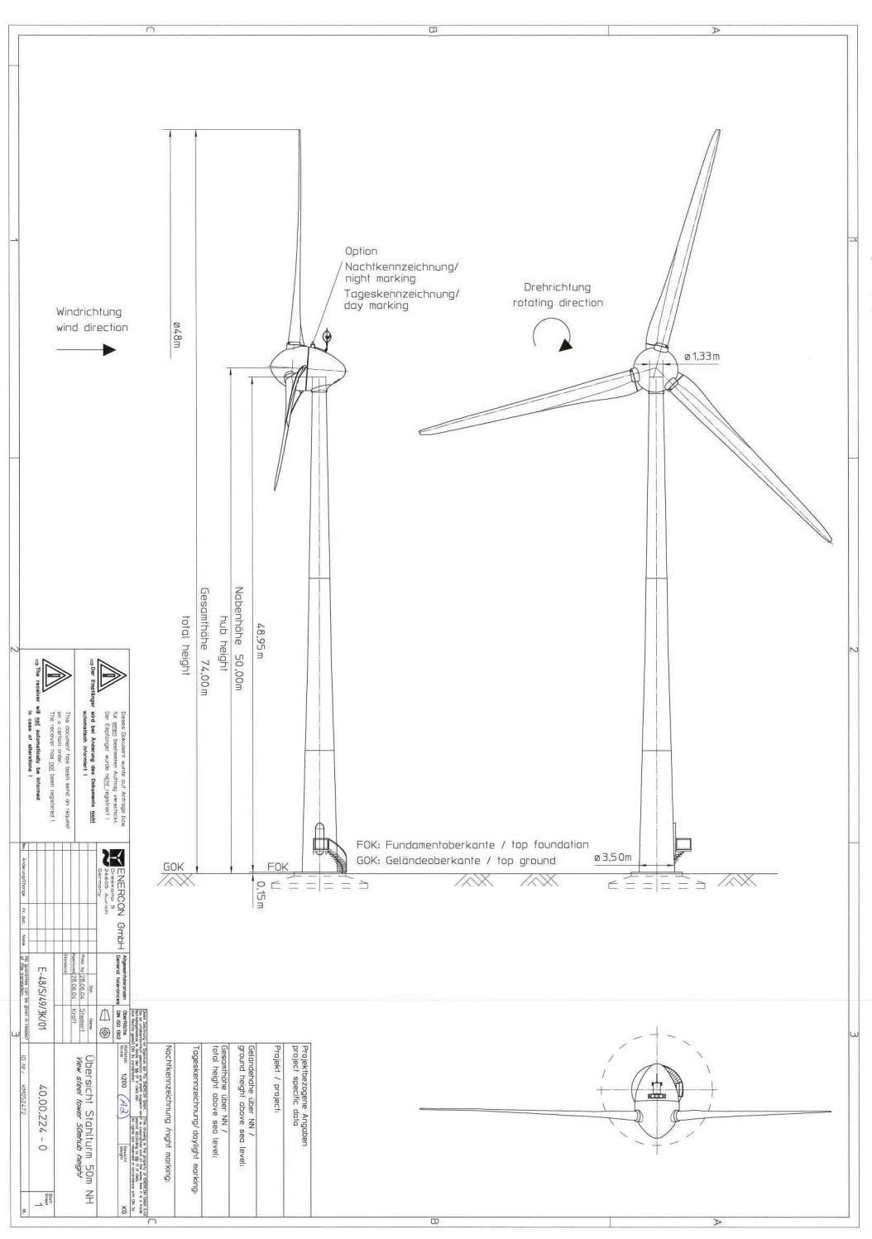

Slide 6
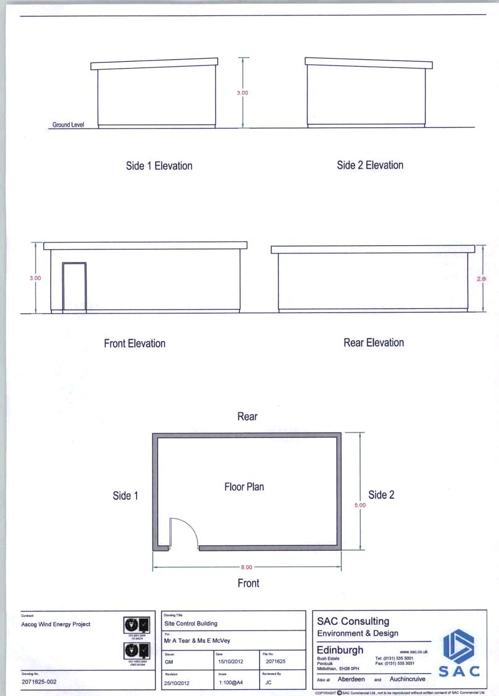

Slide 7
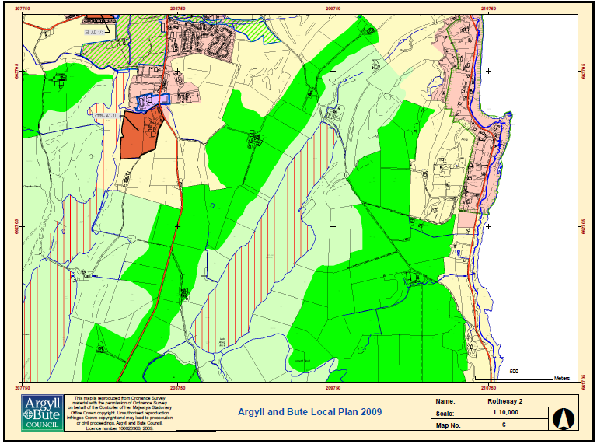

Slide 8
PRINCIPAL DEVELOPMENT PLAN POLICIES
‘Argyll & Bute Structure Plan’ (2002)
STRAT DC 4 – Development in Rural Opportunity Areas
STRAT DC 5 –Development in Sensitive Countryside;
STRAT DC 8 –Landscape and Development Control;
STRAT RE 1 –Wind Farm/Wind Farm Turbine Development.
‘Argyll & Bute Local Plan’ (2009)
LP ENV 1 Development Impact on the General Environment;
LP ENV 10 Development Impact on Areas of Panoramic Quality (APQs);
LP ENV 19 Development Setting, Layout and Design (including Appendix A Sustainable Siting and Design Principles);
LP REN 1 Wind Farms and Wind Turbines;

Slide 9
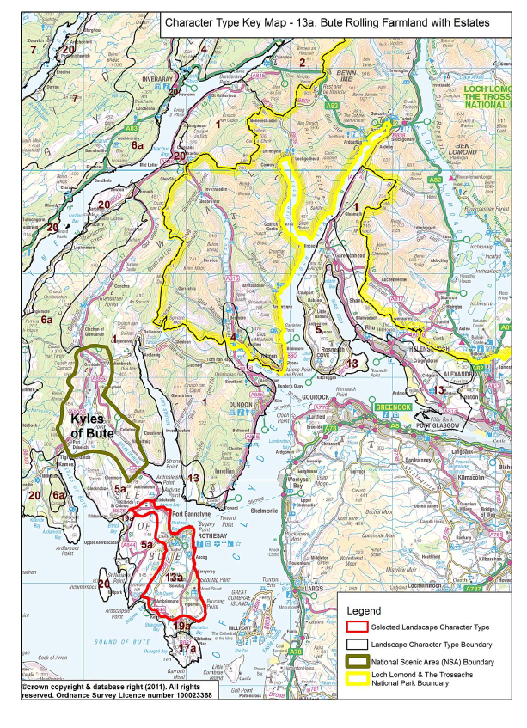

Slide 10
‘Argyll and Bute Landscape Wind Energy Capacity Study’, March 2012
For the purposes of the LWECS, the application site is located within the Landscape Character Type (LCT) known as “Bute Rolling Farmland with Estates”. The summary of the sensitivity of this LCT is as follows:
“The visual sensitivity is high for the small-medium typology (i.e. between 35 metres to 50 metres to blade tip)” and, as a consequence, it would be high for a medium typology of between 50 metres to 80 metres to blade tip;
“There is currently no operational or consented wind farm development in this character type”;
“The relatively low-lying landscape of gently rolling small hedged pastures and extensive wooded policies forms a lush pastoral scene contrasting with the more rugged higher ground on north Bute and the exposed landscapes of the west coast. There would be a high-medium landscape sensitivity to the small-medium typology” and, consequently, a high landscape sensitivity to medium typology, “due principally to the effect of taller turbines on the scale of the landform, its diverse vegetation cover and on settlement”;

Slide 11
‘Argyll and Bute Landscape Wind Energy Capacity Study’, March 2012 cont/..
“The landscape is covered by an Area of Panoramic Quality and Mount Stuart is listed in the Inventory of Gardens and Designed Landscapes and extends over a considerable part of this character type. Sensitivity in terms of landscape values would be high-medium for the small-medium typology” and, consequently, high for the medium typology.
Based on the guidance contained in the Landscape Wind Energy Capacity Study and the conclusions expressed by SNH in respect of landscape impacts of the proposal, it is considered that approval of the proposal could establish a harmful precedent in approving wind turbines that are too large for their respective landscape settings. The Council has targeted areas for larger wind turbines, but the LWECS guidance suggests that only the smallest wind turbine typologies may be more appropriate in this general location, where they do not exert such a degree of influence over the appreciation of the coast and those landscapes which are characterised by the interplay between the land and the sea.

Slide 12
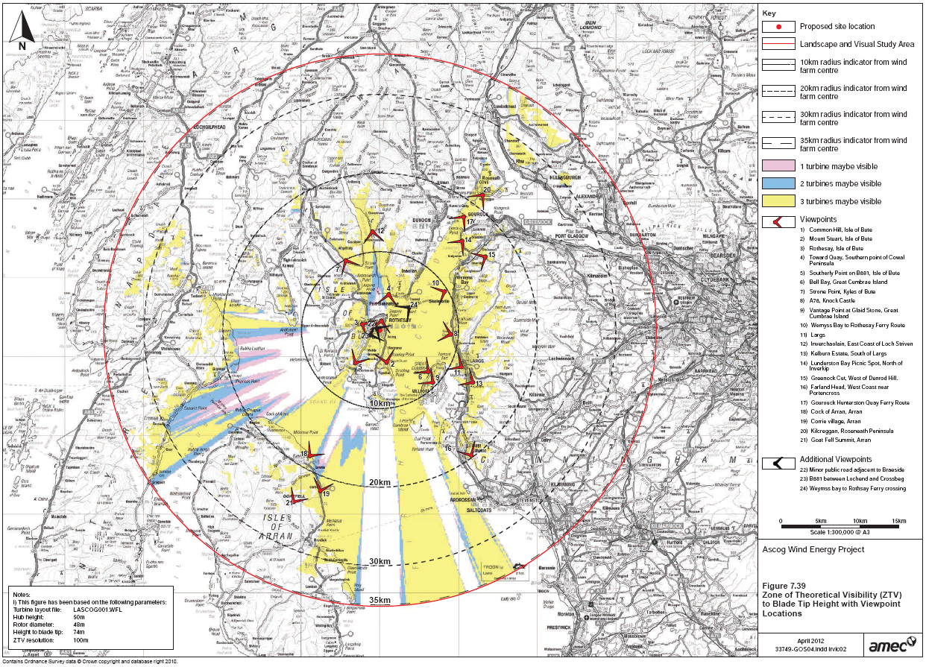

Slide 13
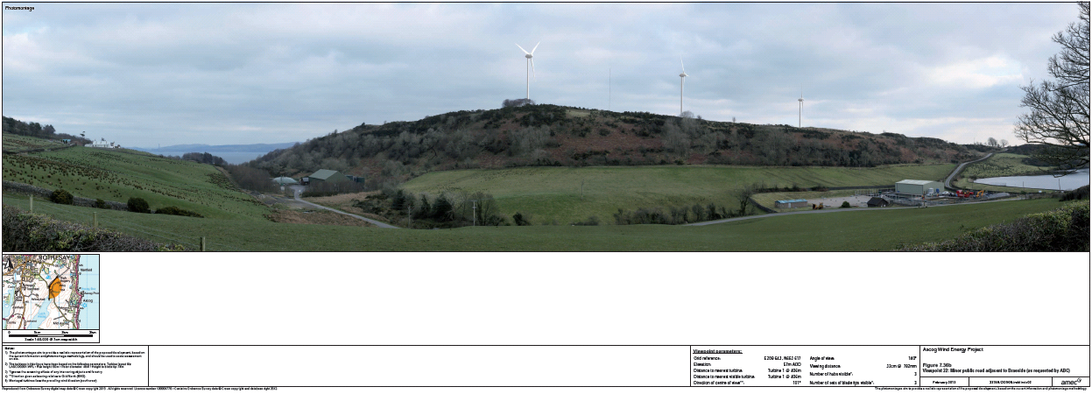

Slide 15
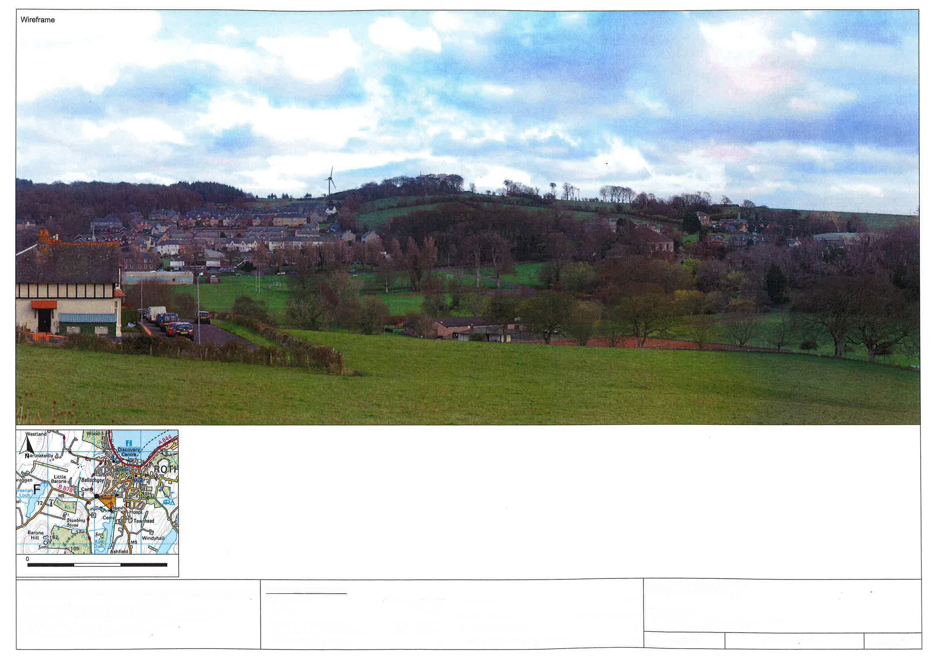

Slide 16
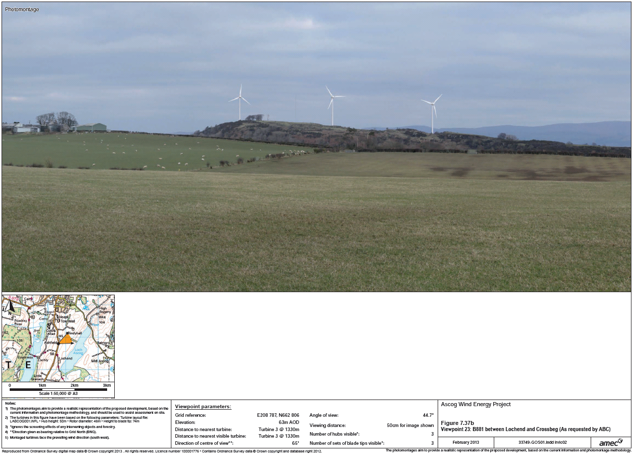

Slide 17
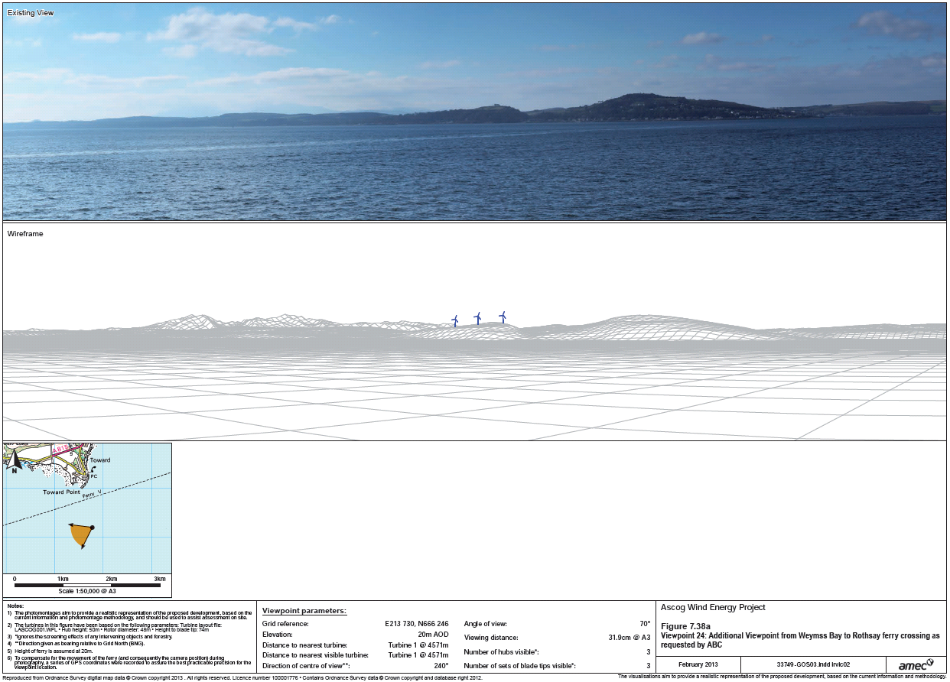

Slide 18
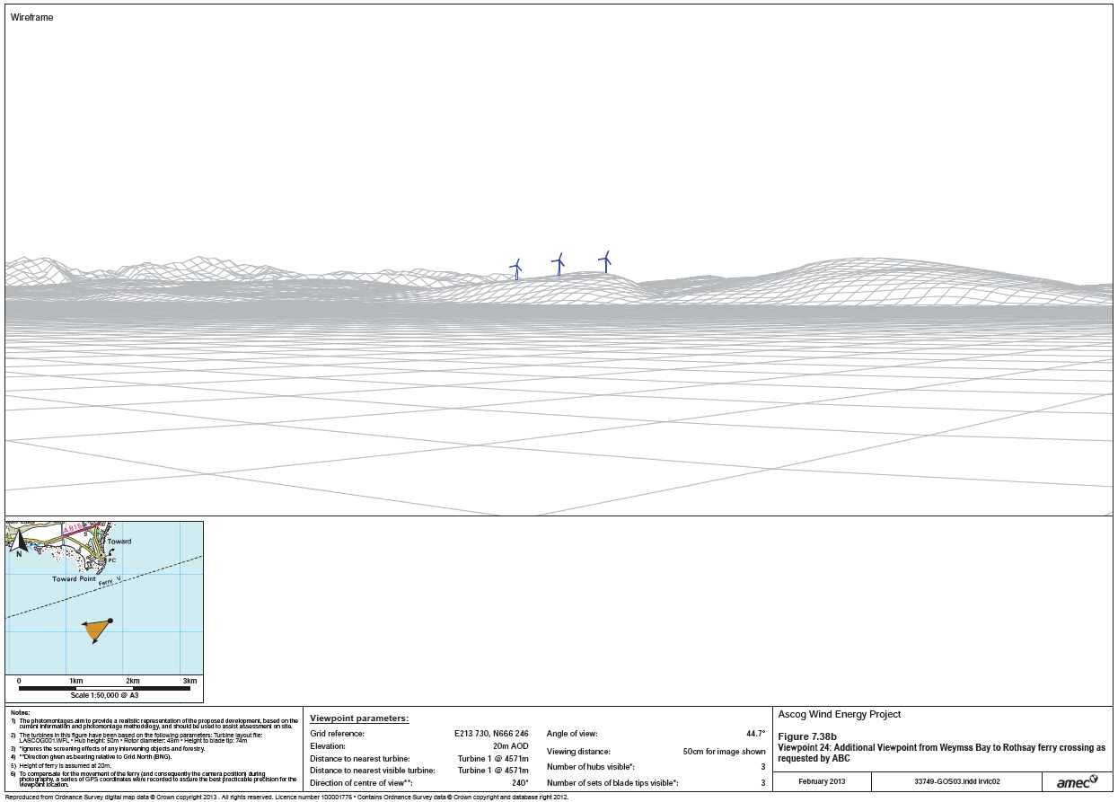

Slide 19
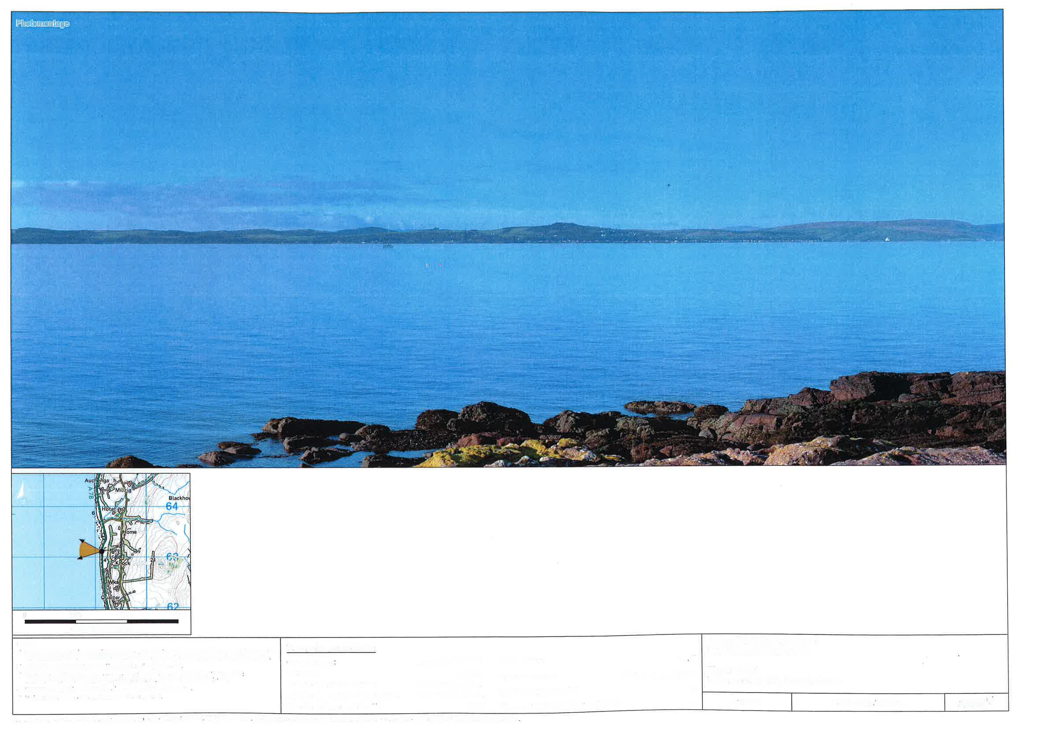

Slide 20
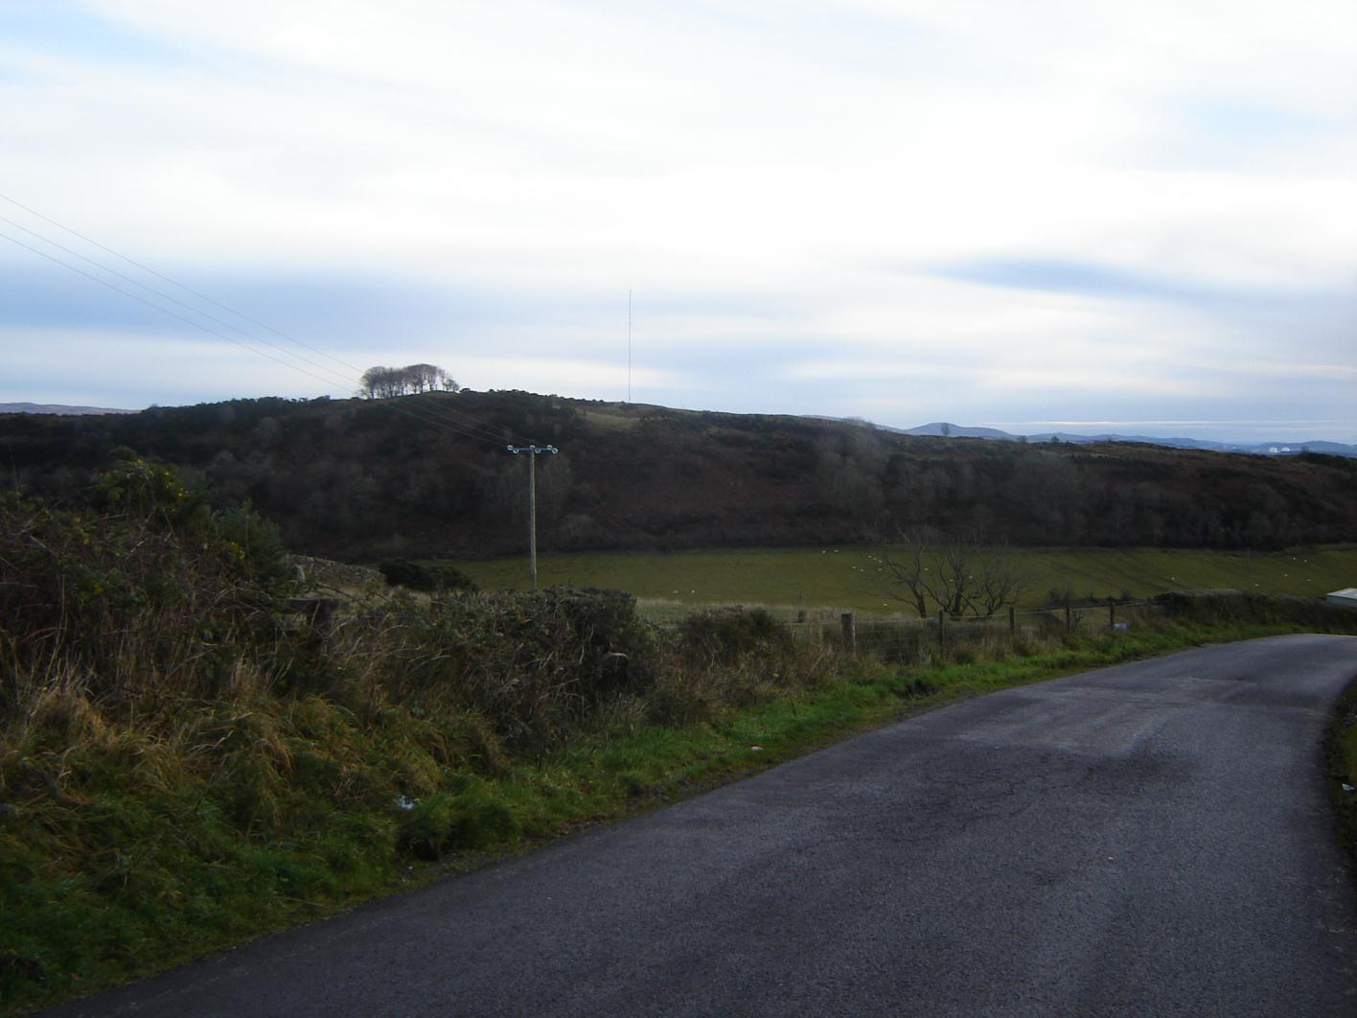

Slide 21
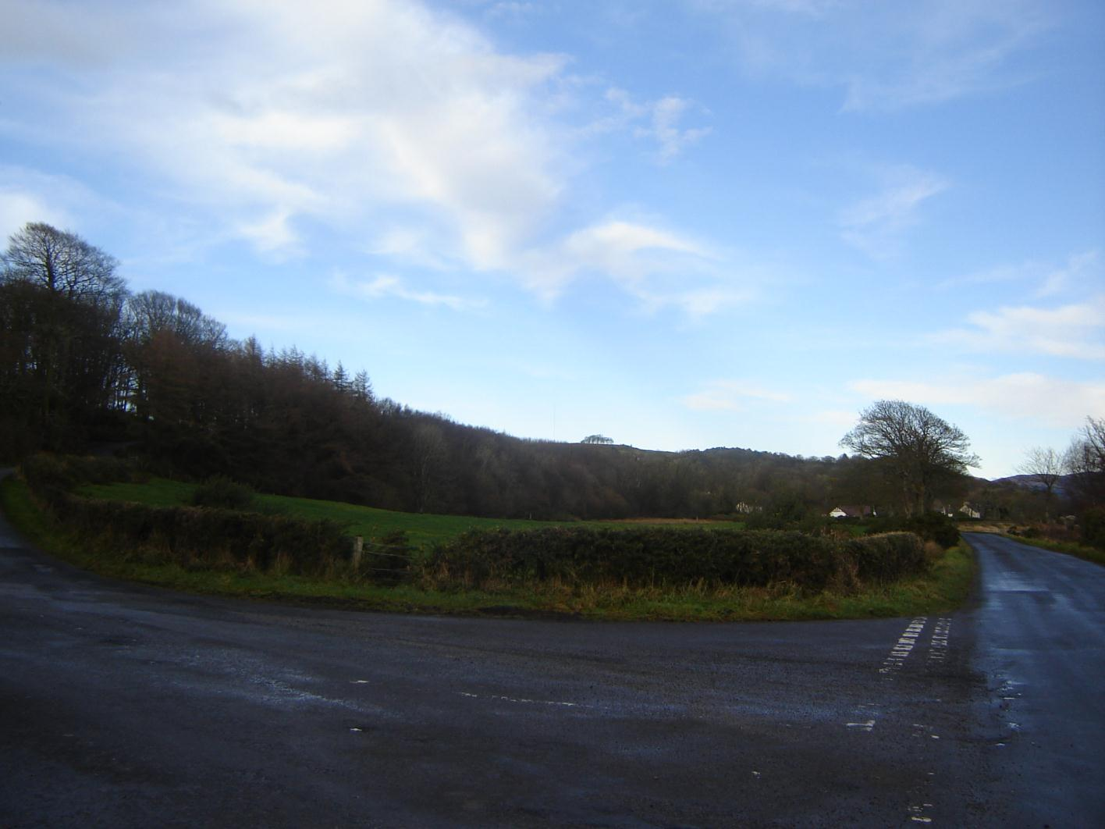

Slide 23
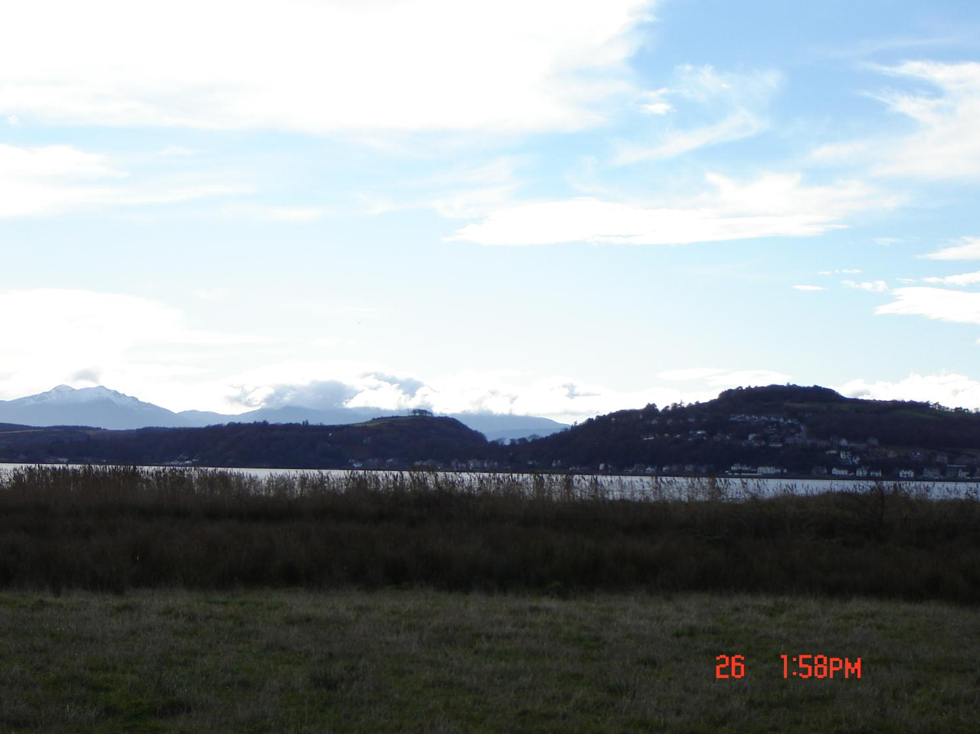

Slide 24
End of
Ref: 12/02202/PP

